Slide 1
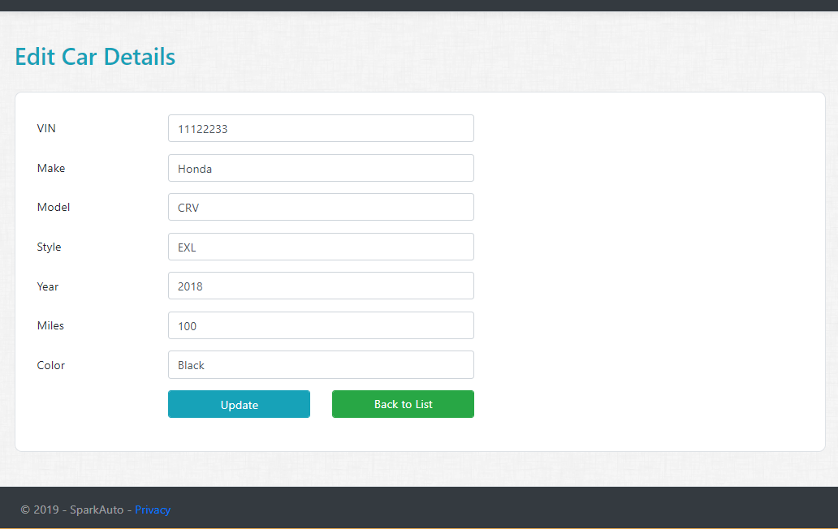
Assignment 5
Cars Edit Razor Page
Create Edit Car Razor Page with Page model and add GET handler.
Modify Edit Car Razor Page (UI) and design the page.
HINT : Get handler will receive User ID (string).
Modify Edit Car Razor Page model and add POST Handler.
HINT : Take advantage of Bind Property.

Slide 2
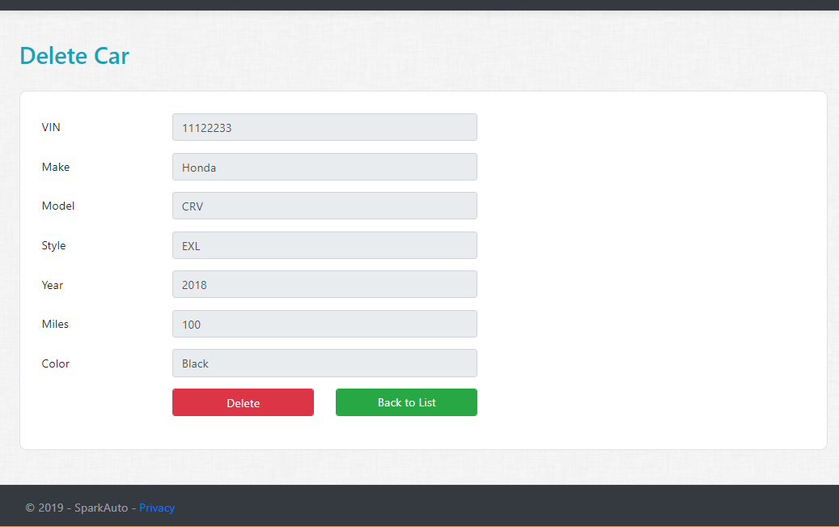
Assignment 6
Car’s Delete Razor Page
Create Delete Car Razor Page with Page model and add GET handler.
Modify Delete Car Razor Page (UI) and design the page.
HINT : Get handler will receive User ID (string).
Modify Delete Car Razor Page model and add POST Handler.
HINT : Take advantage of Bind Property.

